Slide 1
Expedia Hotel Recommendation
Rankings & Sentiment Analysis

Slide 2
Problem Statement
Recommending best hotel group for a query
Ranking hotels based on parameters
User review - sentiment analysis
Real time review consideration

Slide 3
Dataset Information
Expedia hotel group recommendation
37.67 million records (train dataset)
2.5 million records (test dataset)
Expedia hotel rankings
9.9 million records (train dataset)
6.6 million records (test dataset)
Hotel reviews – sentiment analysis
1,36,000 records

Slide 4
Data Analysis
Continent-wise number of bookings over several months
Click-Booking rate
Marketing Channel Performance
Comparison of Business from various Expedia sites

Slide 5
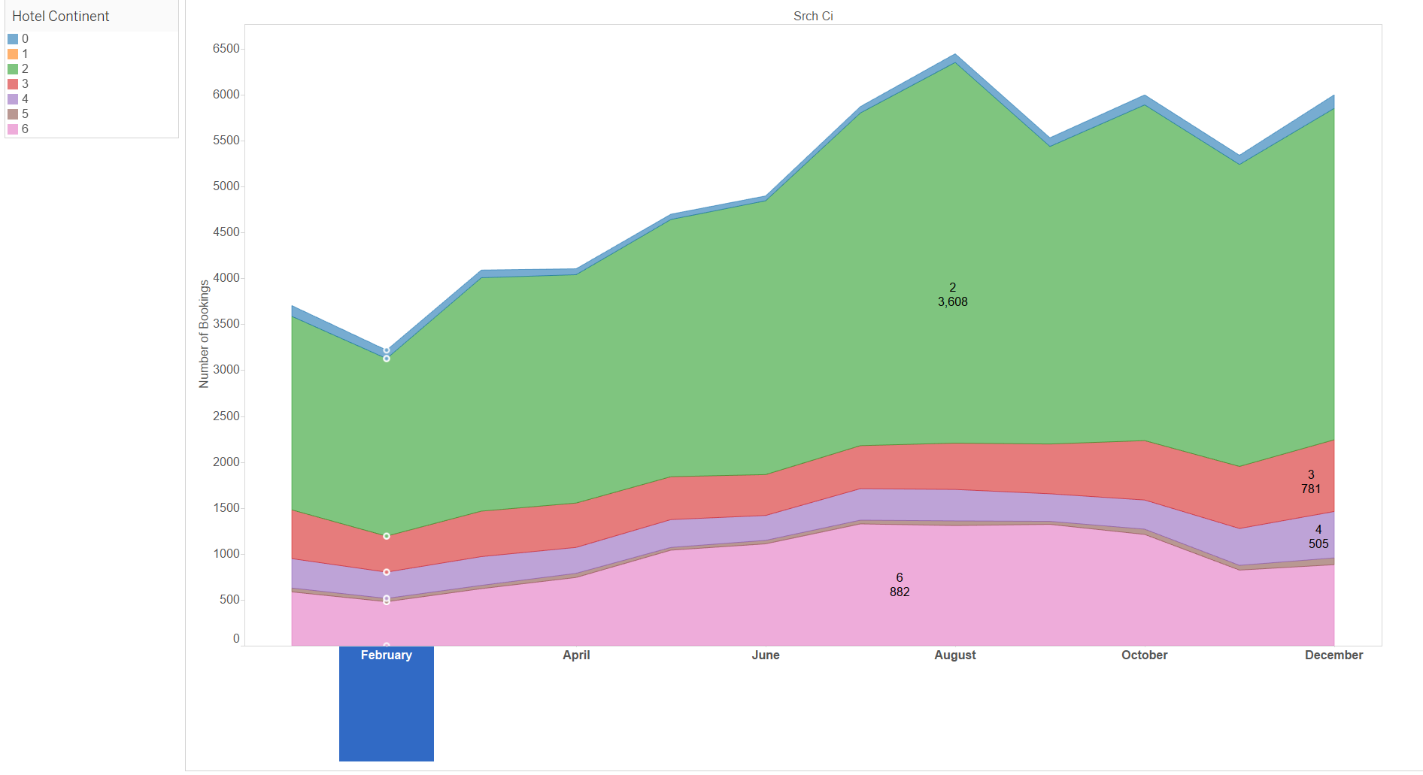
Continent-wise bookings over time

Slide 6
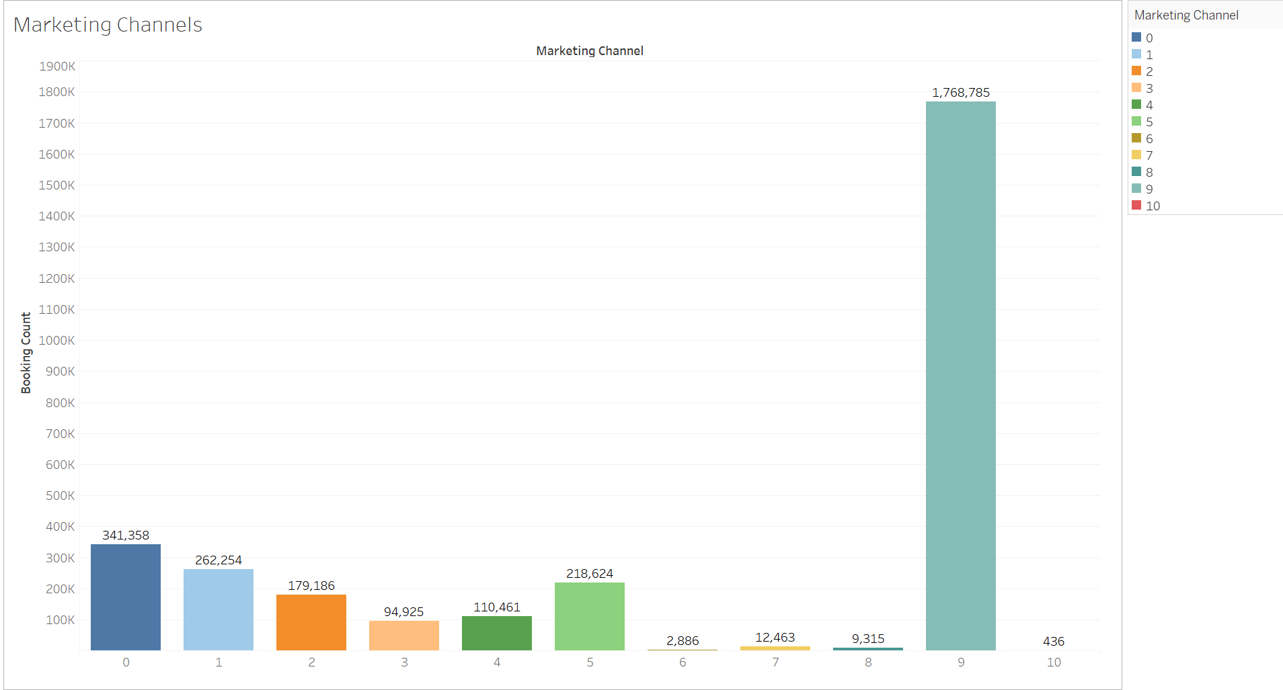
Marketing Channel Performance

Slide 7
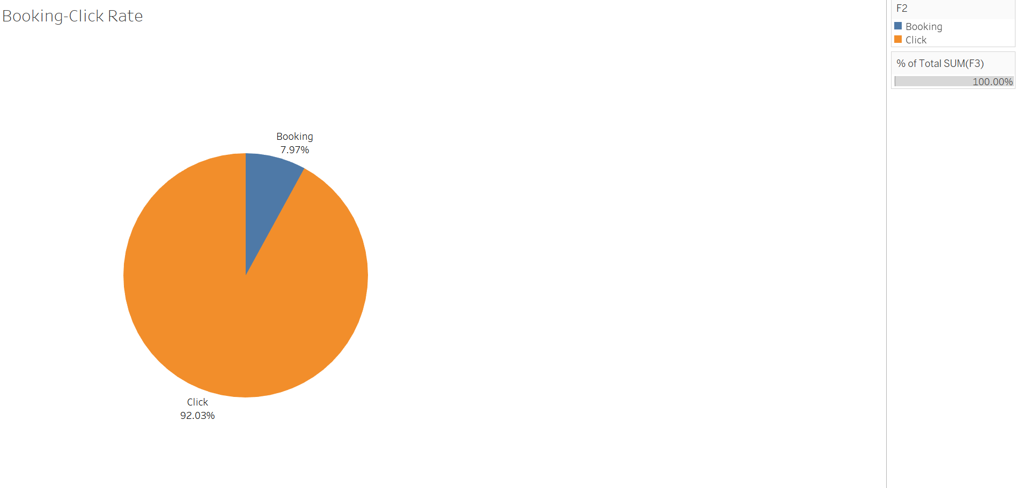
Click vs Booking Rate

Slide 8
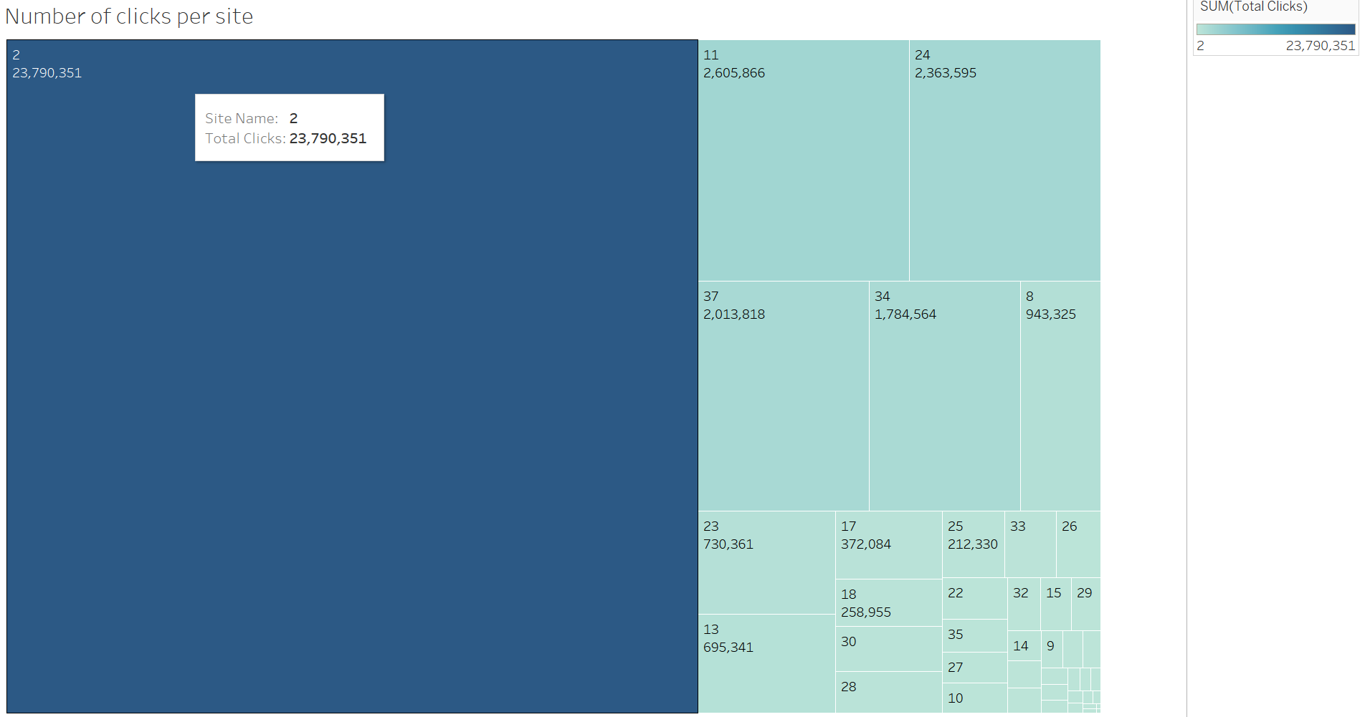
Comparison of Business from various Expedia sites

Slide 9
Application-wide Integration

Slide 10
Sentiment Analysis
Rest based API consumed to pull reviews from Expedia Affiliate Network support for community developer per hotel
Designed map reduce job to aggregate the score for each hotel
Consumed Stanford NLP to calculate review sentiment score
Stanford utilizes recursive neural network internally
Stanford NLP sensitive enough to realize the context of a user review
Eg: This hotel is NOT GOOD

Slide 11
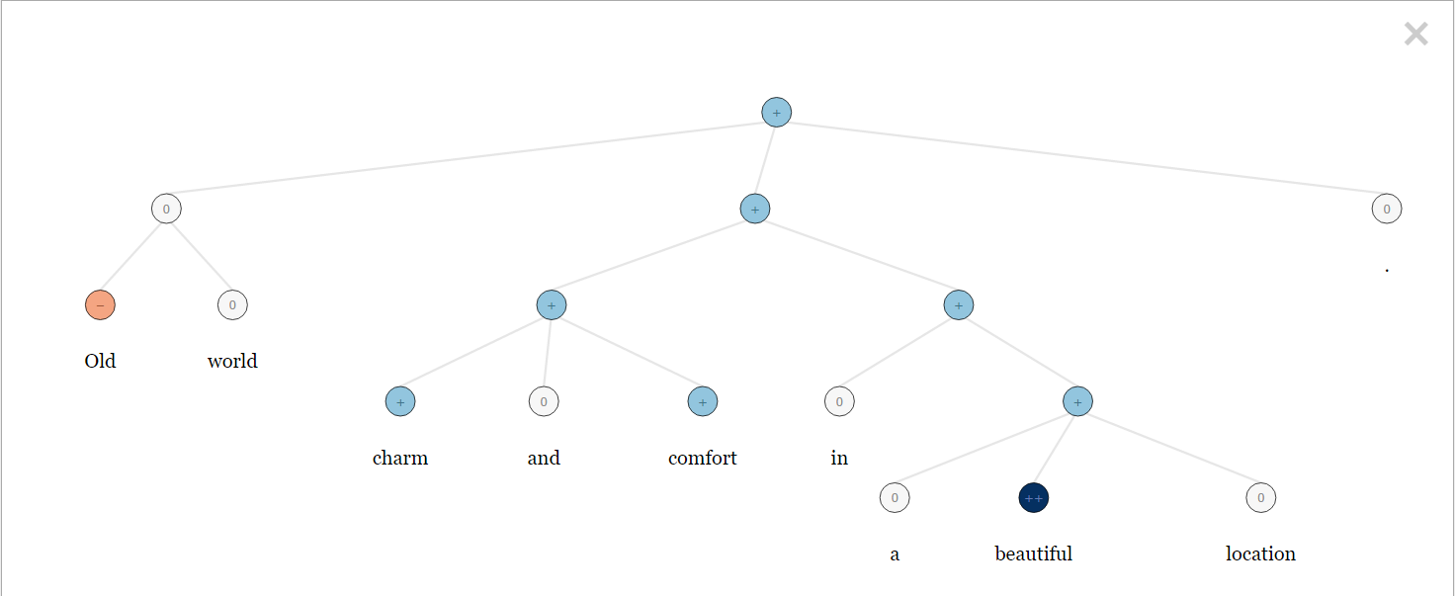
Sentiment Analysis – RCN example - Old world charm and comfort in a beautiful location.

Slide 12
Machine Learning
Feature selection
Random forest vs Decision Jungle vs Neural Network
Algorithm | Overall Accuracy(%) | Average Accuracy(%)
Random Forest | 79.36 | 99.5
Decision Jungle | 69.75 | 98.25
Neural Network | 56 | 98.14

Slide 13
Machine Learning
Feature selection
Random forest vs Decision Jungle vs Neural Network
Algorithm | Overall Accuracy(%) | Average Accuracy(%)
Random Forest | 79.36 | 99.5
Decision Jungle | 69.75 | 98.25
Neural Network | 56 | 98.14

Slide 14
Apache Kafka
Distributed streaming platform

Slide 15
Thank you & Questions!!

